Slide 1
GNU Schedule
For lack of a better name at development time

Slide 2
Purposes and scale
Scheduling in 5 minute increments
Allowing access based on school enrollment
Circumvent or avoid any HIPAA issues, i.e.
Have some kind of HIPAA notice upfront after registration.

Slide 3
Development cycle
Floating personnel model – plenty of work for all.
Emulation of a software development environment or IT department.
Once development of a specific part is finished, those members can join the remaining teams to assist with further development.

Slide 4
3 Teams
Database Team:
Creation of the Database
Placement of dummy data for testing
PHP/HTML Team
Creation of the Graphical Frontend Document
Integration of the Database into the coding schema

Slide 5
3 teams (cont)
Authentication Team
Creation of 2 factor authentication (Email confirmation and password)
Ensuring the security of the system as a whole.

Slide 6

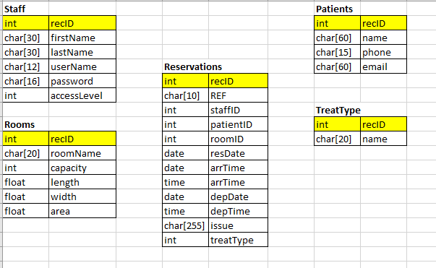
Database Scheme
The actual design of the database is left to the DDT (Database Design Team)

Slide 7
FDT (Frontend development team)
Functions to write in HTML/PHP/SQL
Scheduling Function
DB Connect Function
Authentication Function (to be coordinated with Authentication Team)
Profile Creation and Maintenance Function
Administrative Functions (Patient Case Closed, Referral to ER, Patient Outcome)

Slide 8
Authentication team (A-Team)
Creation of the scheme of authentication and encryption of profile passwords.
Creation of the email authentication/profile creation scheme.
Sequence:
User submission of gcc.edu email.
Ping from the webserver to the gcc email server to see if the email exists.
If the email exists;
Send authentication email with 6 digit code which will expire in 1 hour.

Slide 9
Authentication team (a-team)
After the token is entered, a user may be able to create the profile, which then will be eligible for creating an appointment.
I suggest Python/HTML/PHP for the authentication process.
Import os.system

Slide 10
Final suggestions
Separate bi-weekly development meetings, either virtually via Discord or on campus to discuss development cycle, application progress and to share code.
Suggestions on technologies to implement;
Python, PHP, HTML, SQL
Anymore?
For testing purposes, I have webspace available.

